Slide 1
Hotel Reservation Analysis with SQL
BY: AHMED MAHMOUD
Batch Name: MIP-DA-10

Slide 2
Overview:
The hotel industry relies on data to make informed decisions and provide a better guest experience and other key factors that impact the hotel's operations.

Slide 3
The dataset includes the following columns:
Booking_ID: A unique identifier for each hotel reservation. •
no_of_adults: The number of adults in the reservation.
no_of_children: The number of children in the reservation.
no_of_weekend_nights: The number of nights in the reservation that fall on weekends
no_of_week_nights: The number of nights in the reservation that fall on weekdays.
type_of_meal_plan: The meal plan chosen by the guests.
room_type_reserved: The type of room reserved by the guests.
lead_time: The number of days between booking and arrival.
arrival_date: The date of arrival.
•market_segment_type: The market segment to which the reservation belongs. •
avg_price_per_room: The average price per room in the reservation.
•booking_status: The status of the booking.
Dataset Details:

Slide 4

What is the total number of reservations in the dataset?
Which meal plan is the most popular among guests?
What is the average price per room for reservations involving children?
How many reservations were made for the year 20XX (replace XX with the desired year)?
What is the most commonly booked room type?
How many reservations fall on a weekend (no_of_weekend_nights > 0)?
What is the highest and lowest lead time for reservations?
What is the most common market segment type for reservations?
How many reservations have a booking status of "Confirmed"?
What is the total number of adults and children across all reservations?
What is the average number of weekend nights for reservations involving children?
How many reservations were made in each month of the year?
What is the average number of nights (both weekend and weekday) spent by guests for each room type?
For reservations involving children, what is the most common room type, and what is the average price for that room type?
Find the market segment type that generates the highest average price per room.
SQL Problem Statements

Slide 5
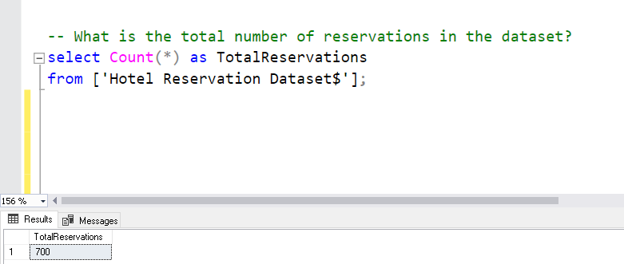

Q1: What is the total number of reservations in the dataset?

Slide 6
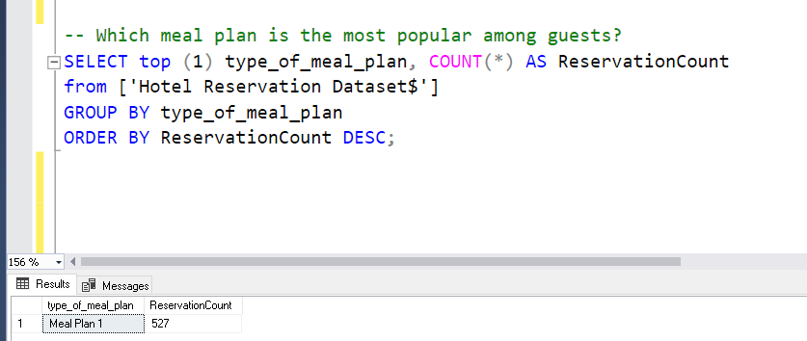

Q2: Which meal plan is the most popular among guests?

Slide 7
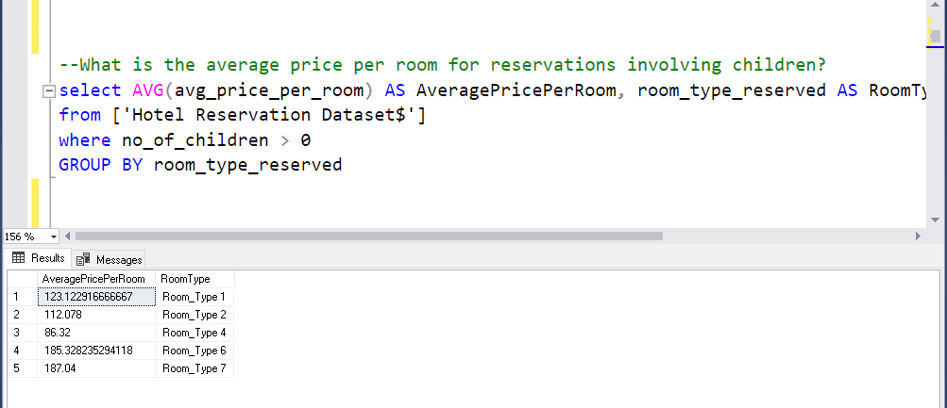
Q3: What is the average price per room for reservations involving children?

Slide 8
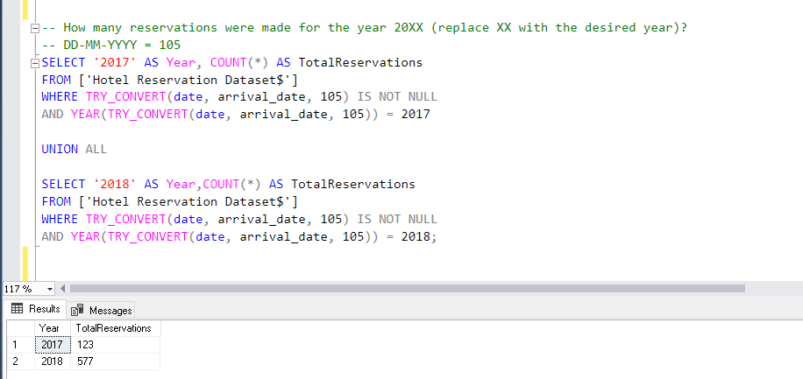
Q4: How many reservations were made for the year 20XX (replace XX with the desired year)?

Slide 9
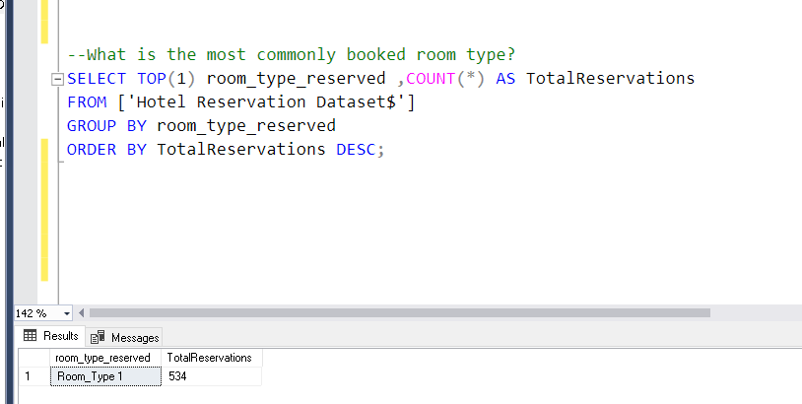
Q5: What is the most commonly booked room type?

Slide 10
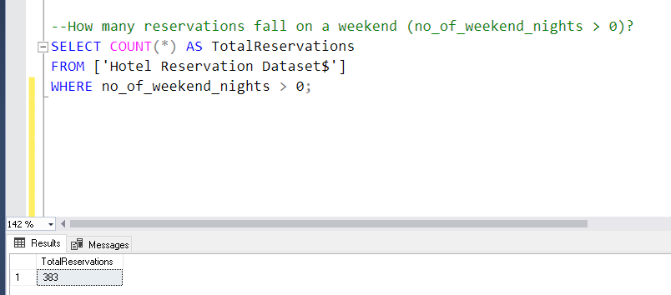
Q6: How many reservations fall on a weekend (no_of_weekend_nights > 0)?

Slide 11
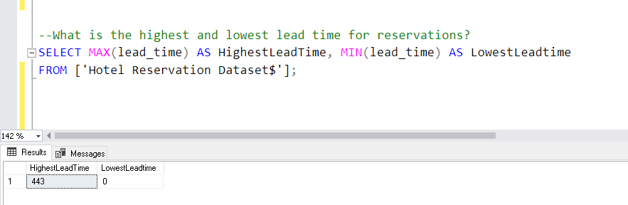
Q7: What is the highest and lowest lead time for reservations?

Slide 12
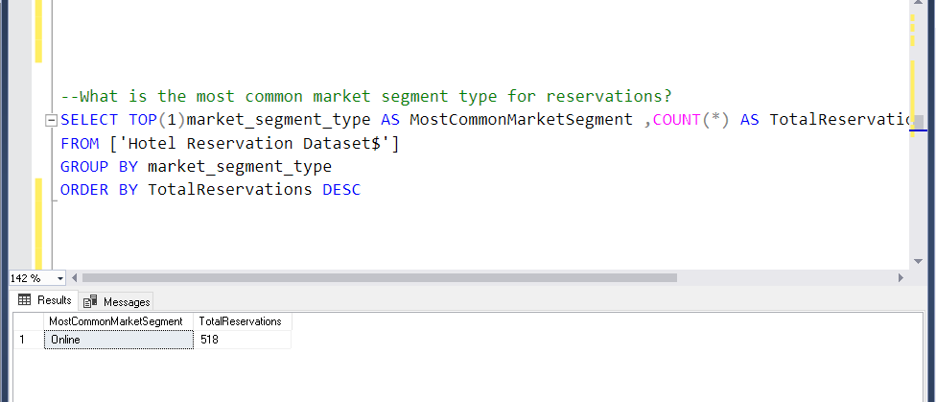
Q8: What is the most common market segment type for reservations?

Slide 13
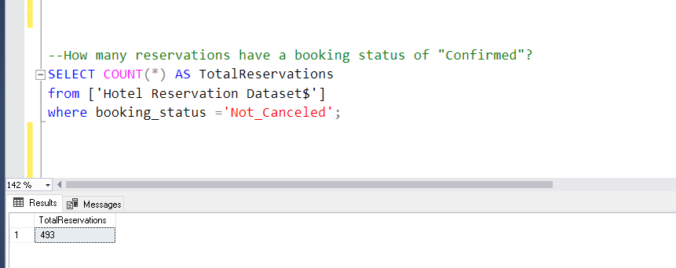
Q9: How many reservations have a booking status of "Confirmed"?

Slide 14
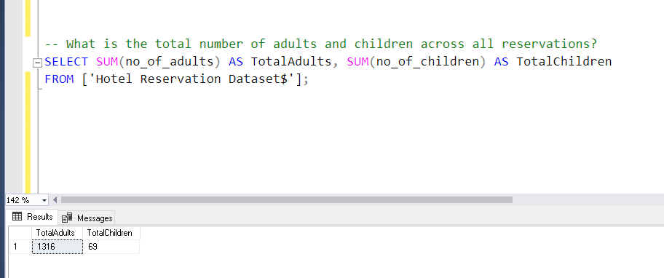
Q10: What is the total number of adults and children across all reservations?

Slide 15
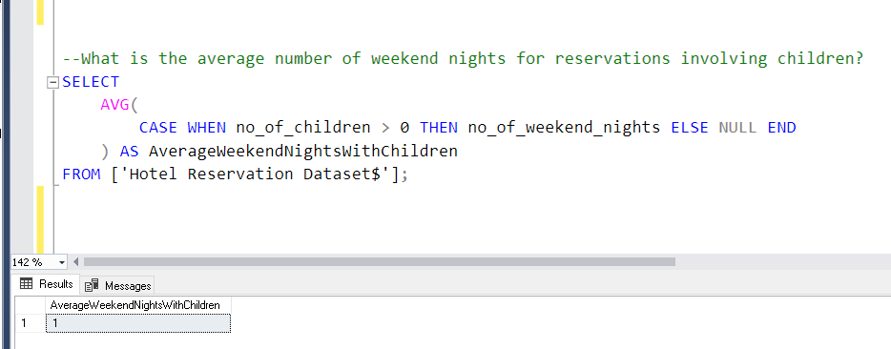
Q11: What is the average number of weekend nights for reservations involving children?

Slide 16
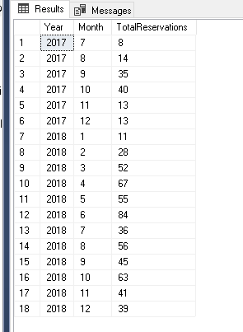
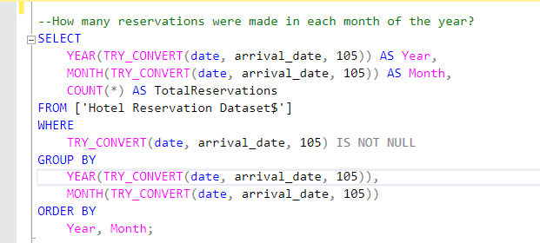
Q12: How many reservations were made in each month of the year?

Slide 17
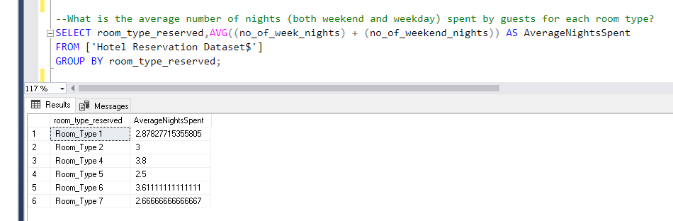
Q13: What is the average number of nights (both weekend and weekday) spent by guests for each room type?

Slide 18
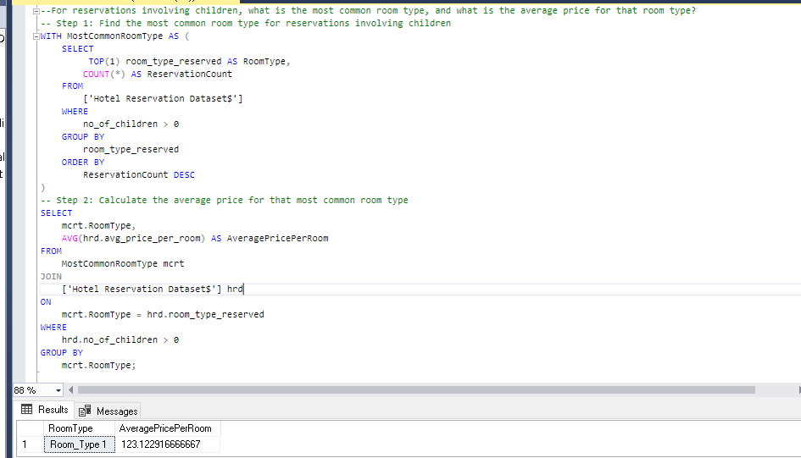
Q14: For reservations involving children, what is the most common room type, and what is the average price for that room type?

Slide 19
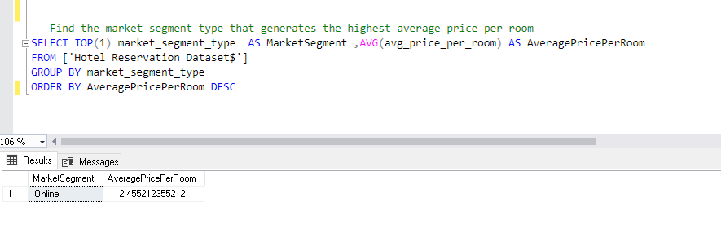
Q15: Find the market segment type that generates the highest average price per room.

Slide 20

Future Scope
The future scope of a project refers to the potential extensions or expansions that can be considered beyond the current project's scope. It outlines the possibilities for further development and growth based on the project's outcomes and learnings. Identifying the future scope helps in strategic planning and resource allocation for future endeavors.
Examples of Future Scope:
Expanding the product line or service offerings
Developing new features or functionalities
Exploring new market segments or geographic regions
Conducting further research or studies to refine findings
Scaling the project's impact to a wider audience or population
Integrating the project's outcomes with other initiatives

Slide 21
Thank you for the time you gave me

